Slide 1
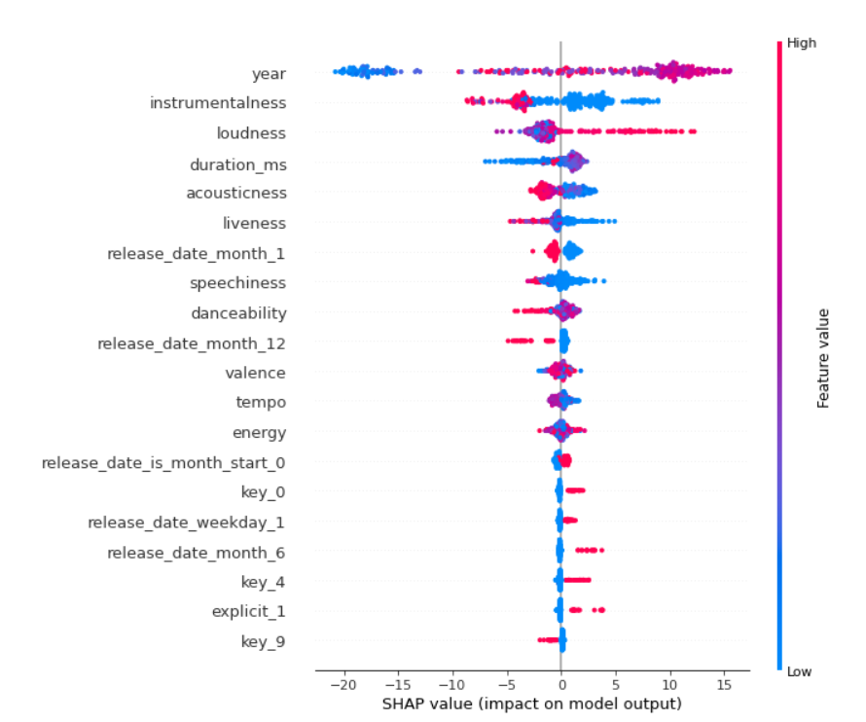
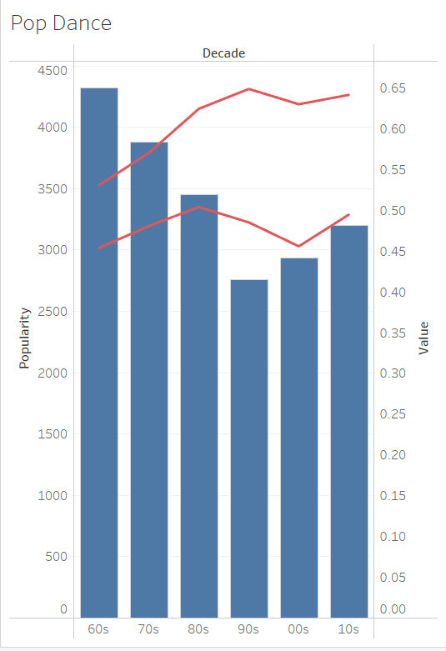
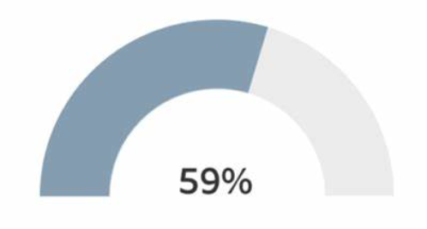
Popular / Non-Popular
Measured Feature
Decade
Other
4,321
Number Songs
i
.5306
.5306
Acoustics avg
Danceability avg
.6552
.6552
Energy avg
Instramentality avg

Slide 2
Popular / Non-Popular
.5306
.5306
Decade
Acoustics avg
Danceability avg
4,321
Other
Number Songs
.6552
.6552
Energy avg
Instramentality avg
Measured Feature
Measured Feature

